Slide 1
Chief Executive Officer Briefing
August 1, 2019

Slide 2
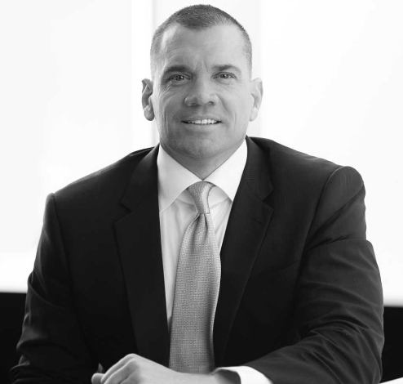
Universal Insurance Holdings (UVE): Change At The Top
Effective July 15, 2019, Sean Downes relinquished his title of CEO and has taken on a new role as Executive Chairman
This move fits with Sean’s family and personal goals after 20 years as an executive of the Company, including the past 6 years as Chairman and CEO
As Executive Chairman, Sean will continue to be involved in ongoing operations of the company, to include strategic decision making, claims practices, and online distribution

Slide 3
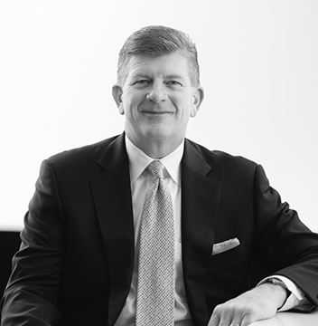

Universal Insurance Holdings (UVE)
The New CEO
Stephen J. Donaghy
Prior responsibilities at Universal include Chief Operating Officer, Chief Marketing Officer, Chief Administrative Officer, and Chief Information Officer
Prior to Universal, served in various roles at JM Family including Vice President of Strategic Initiatives, Vice President of Sales & Marketing, and Senior Information Officer
A diverse background spanning operations, marketing, sales, and strategy

Slide 4
Universal Insurance Holdings (UVE): Growth Story
Leading holding company of personal residential homeowners insurance and services
Doing business
Licensed
$1B+
FY18 Direct Premium Written
#1
Best-in-class Return on Equity
(5-yr Average)
MN
WI
NY
NH
WI
MA
MI
18
States actively doing business
>800K
Customer policies managed
IA
PA
NJ
IL
IN
DE
VA
MD
NC
800+
Full time equivalent employees
9,000+
Independent agents in the distribution channel
SC
AL
GA
FL
Ft. Lauderdale, FL
A
Exceptional
Demotech financial stability rating
HI
Headquarters

Slide 5






















Universal Insurance Holdings (UVE): Historical Timeline
Geographic Expansion
Commenced writing in
DE
Commenced writing in
MI, AL, VA
Commenced writing in
NH, IL
&
Received license in WI
Commenced writing in
SC, HI, NC, GA, MA, MD
Commenced writing in
IN, PA, MN
Commenced writing in
NJ & NY
Prior to FY13
FY14
FY15
FY16
FY17
FY18 & beyond
Launched Commercial residential program through American Platinum
Specialty
Flood partners
Auto partners
E&S homeowners partners
Opportunistically evaluate complementary lines
Homeowners Partners
Complementary lines expansion (offerings / partners)

Slide 6










Universal Insurance Holdings (UVE): Organizational Structure
Protection solutions
Assurance Systems
OAK90
(Formerly Universal Risk Advisors)
(Formerly known as Universal Adjusting)
(Formerly known as Universal Inspection)

Slide 7







Universal Insurance Holdings (UVE): Focus On The Insurance Value Chain
Products
Pricing / Underwriting
Distribution
Policy administration / back office
Claims
Risk Management
(in partnership with Blue Atlantic)
Independent Agents
(in partnership with Evolution)
Insurance offerings
Product specifications
Actuarial analysis / Risk selection
Inspection
Customer experience / Channel management
Direct-to-consumer Sales and Marketing
Policy execution
Quotes / binding / issuing / renewals
Payments & Collections
Claims management
Risk / Catastrophe assessment
Reinsurance programs
Actuarial analysis

Slide 8
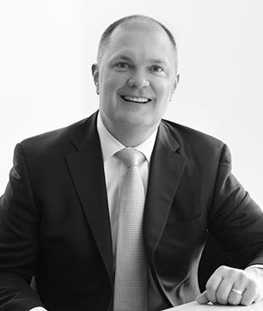
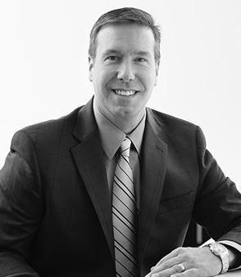
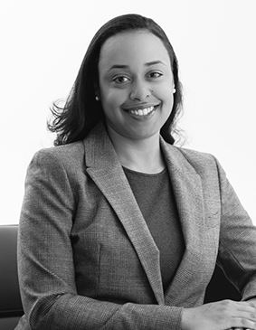
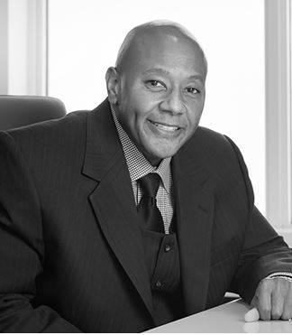
Universal Insurance Holdings (UVE): Corporate HQ
Executive Team
Jon Springer
President & Chief Risk Officer
Frank Wilcox
Chief Financial Officer
Kimberly Cooper-Campos
Chief Information Officer
Darryl Lewis
Chief Legal Officer

Slide 9
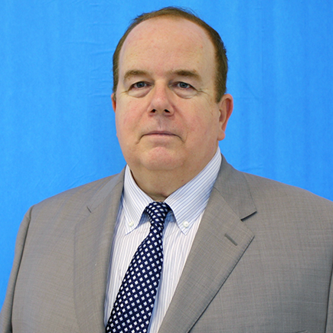
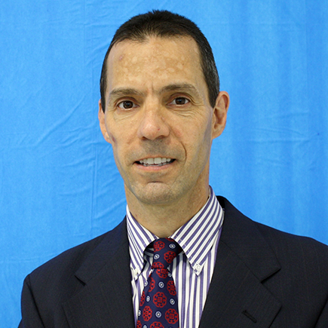
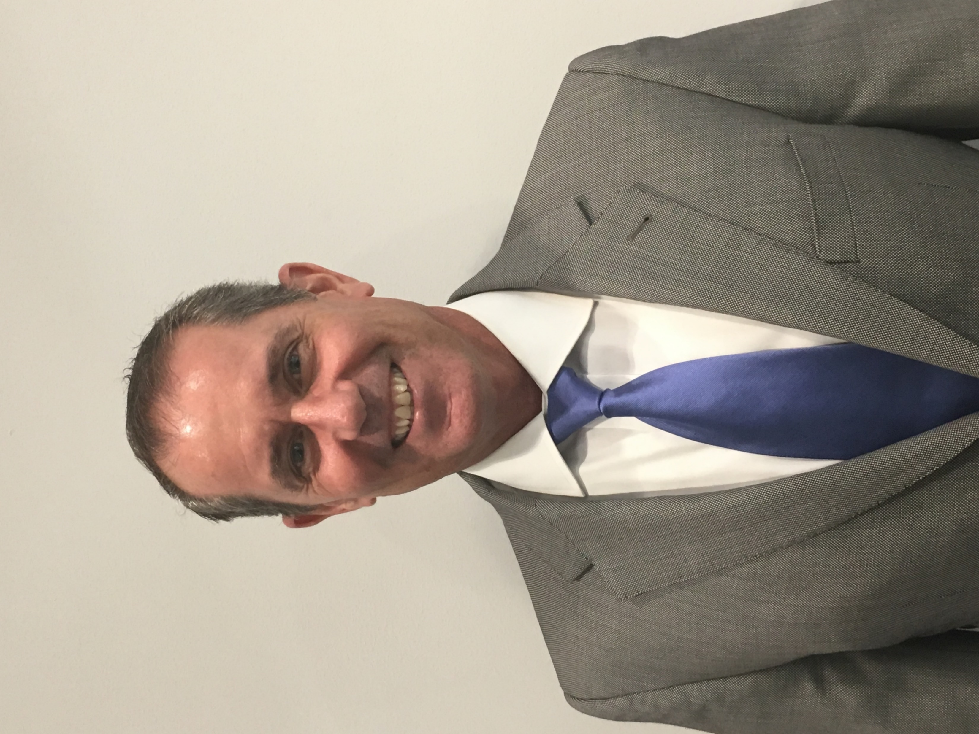
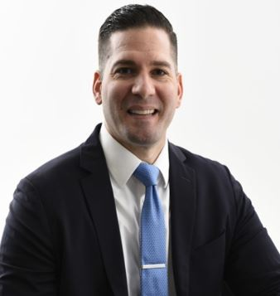
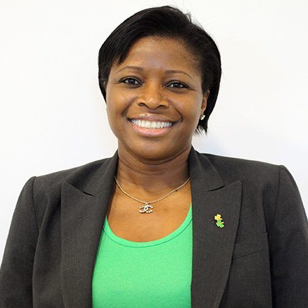
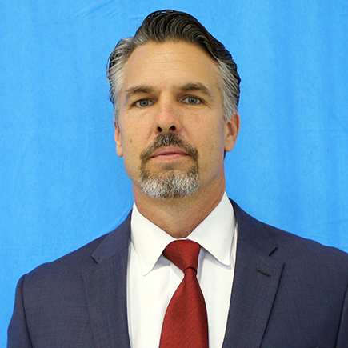
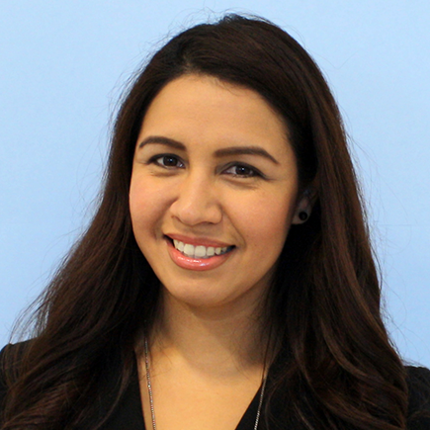
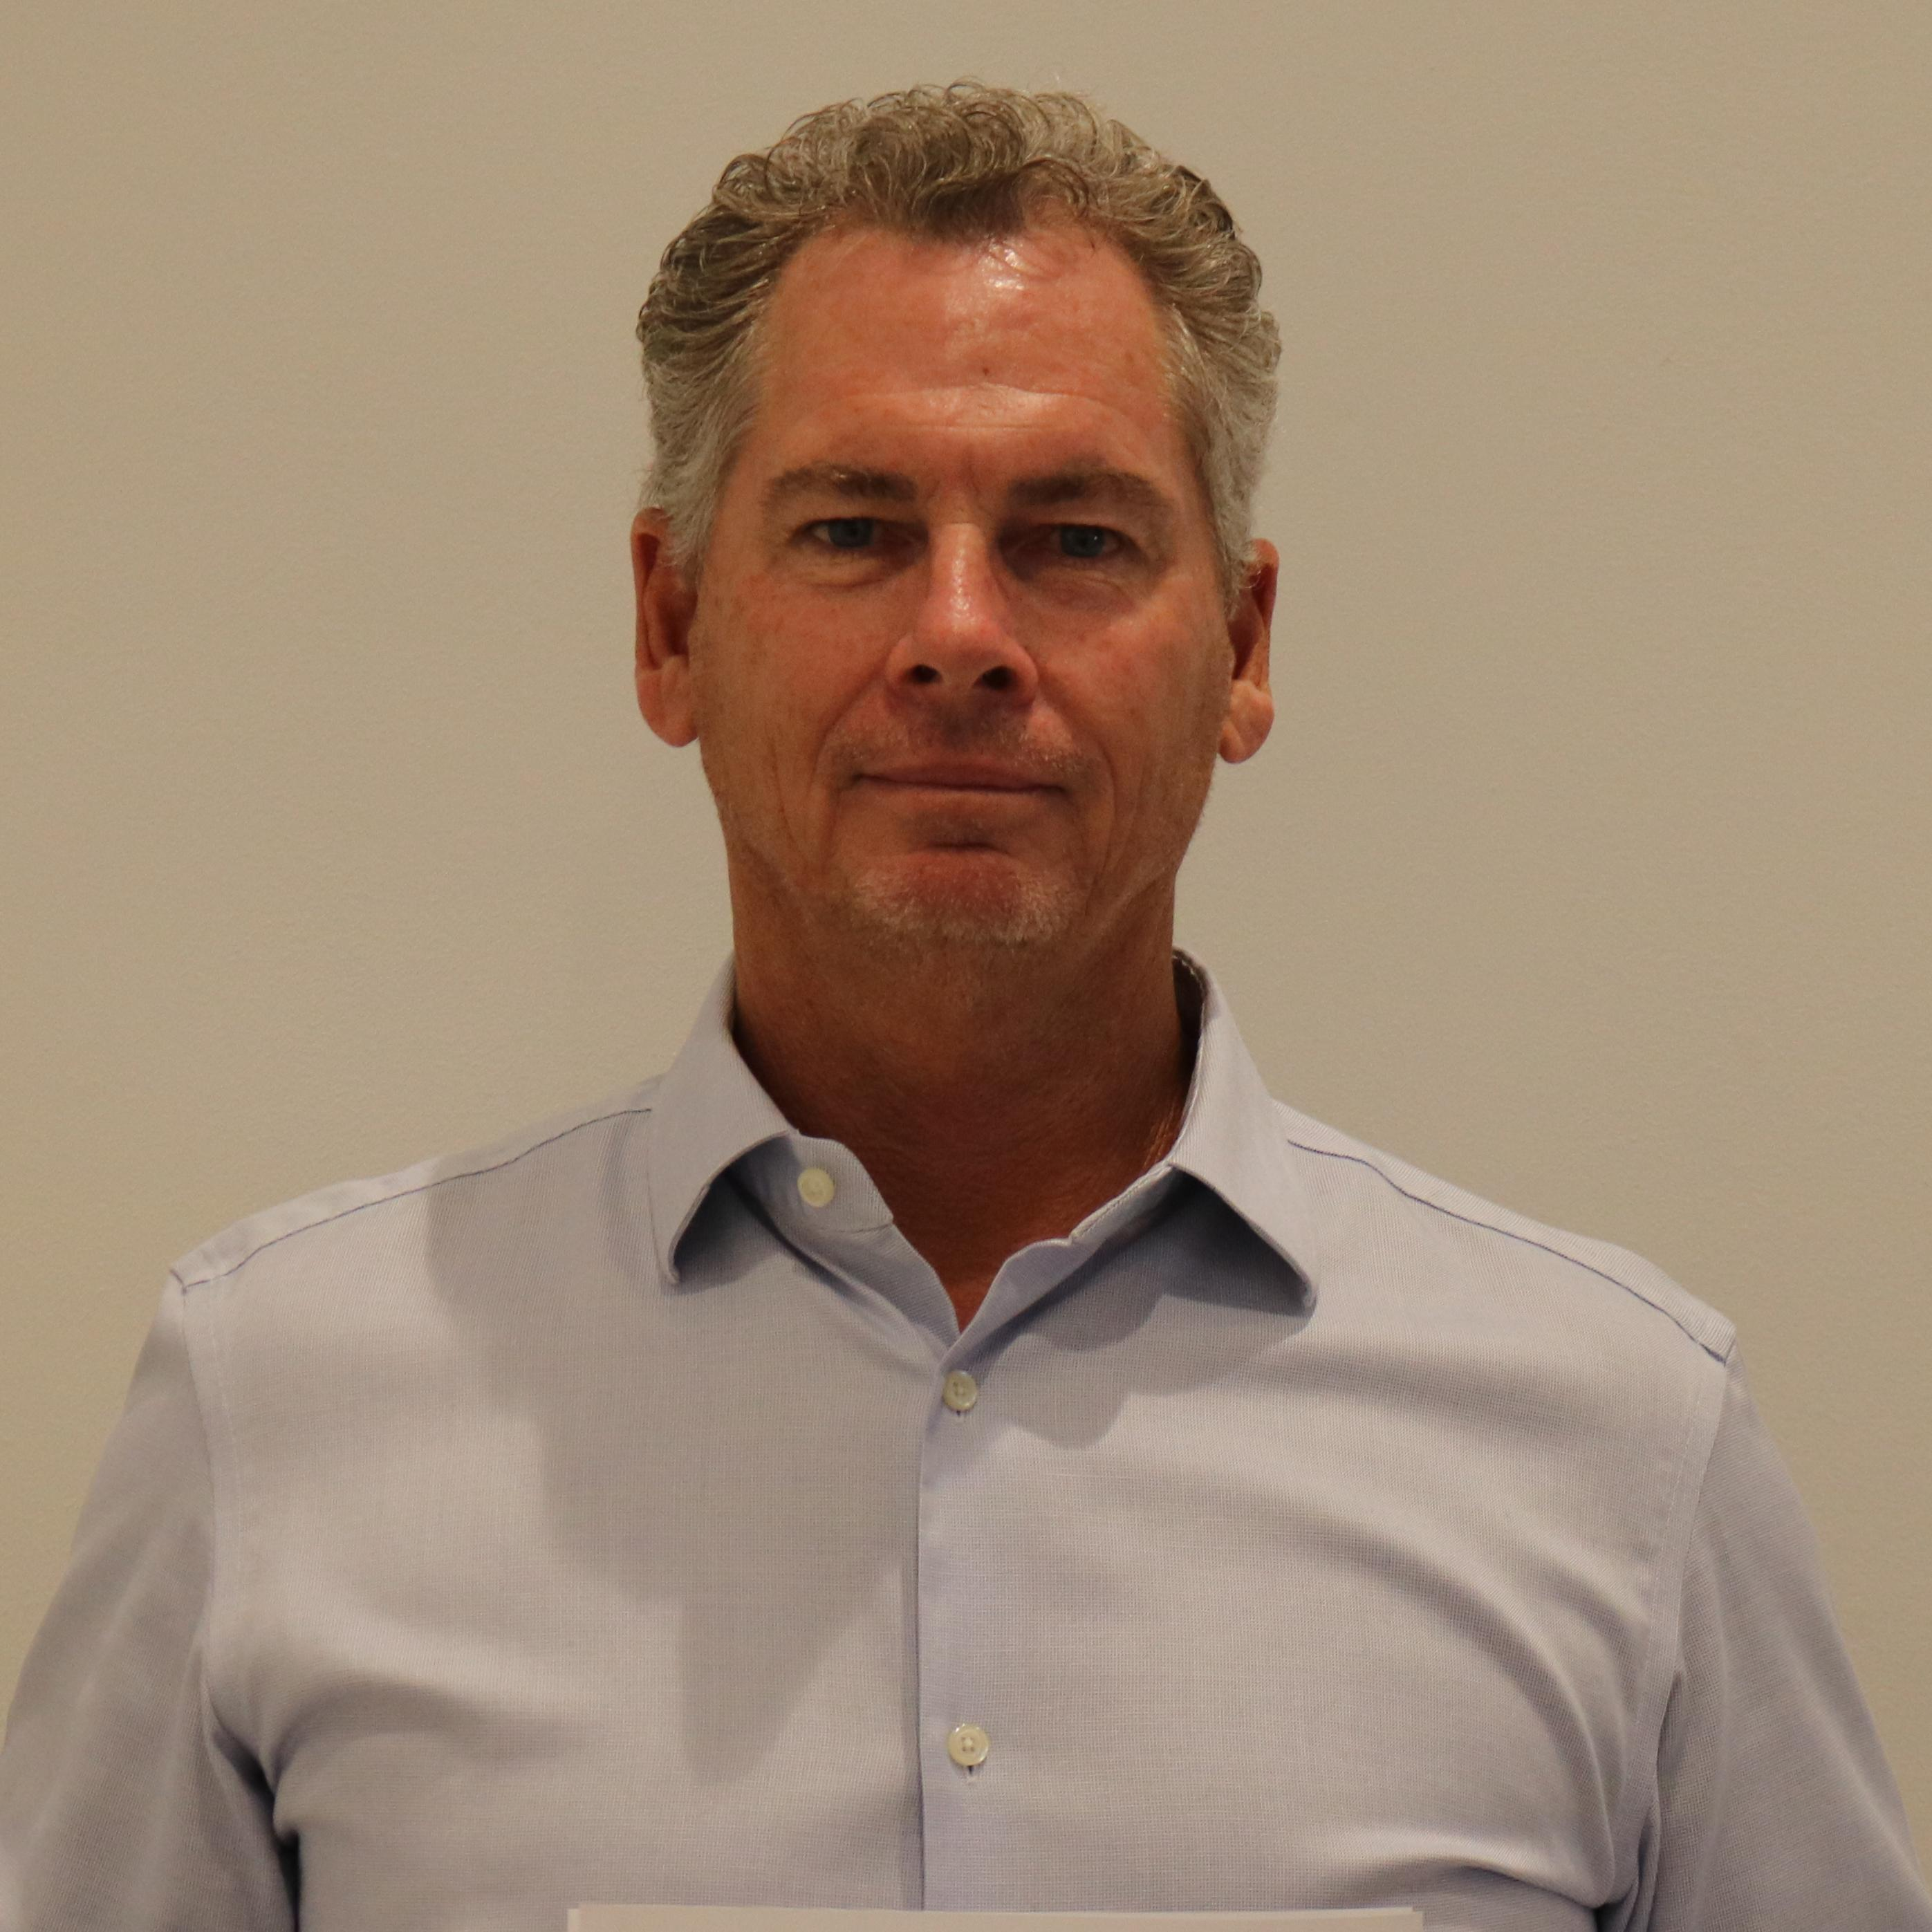
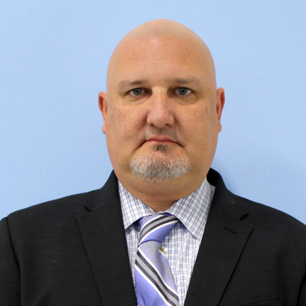
Universal Insurance Holdings (UVE): Corporate HQ
Corporate Functions
Gary Ropiecki
SVP – Corporate Controller
Bill Joyce
SVP of Finance & Statutory Controller
Tom Redmond
SVP – Taxation
Rob Luther
VP Corporate Development, Strategy, & IR
Beth Wallace
Office Manager
Greg Ruth
VP Human Resources
Dania Arnodo
Director of Regulatory Compliance
Bobby Elder
Director of grand Palm Construction
Timothy Wentroble
VP Security

Slide 10
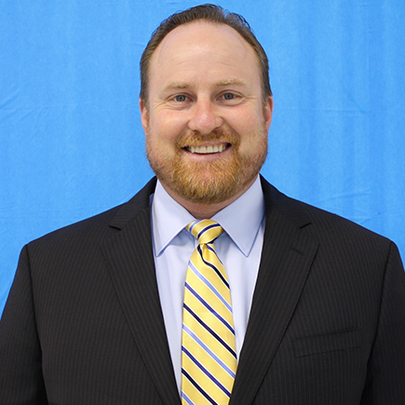
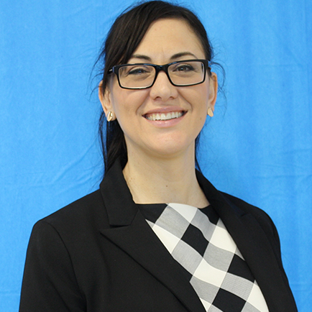
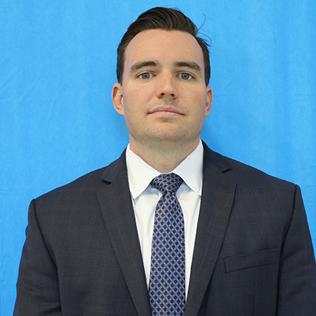
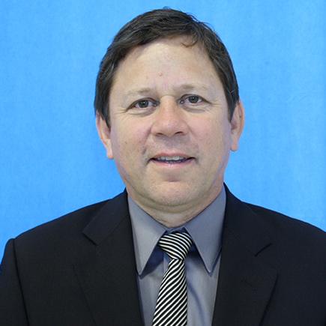
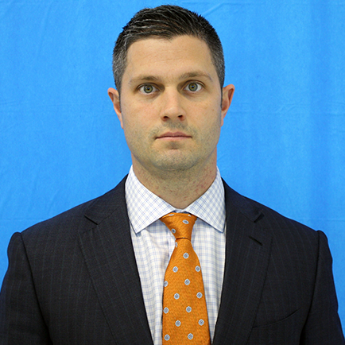
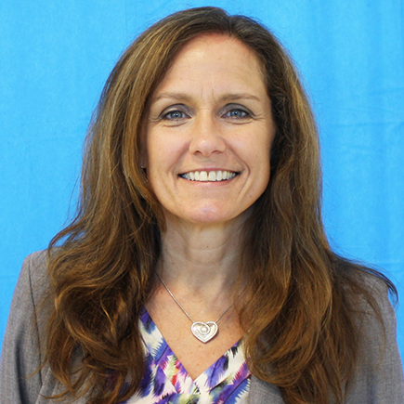
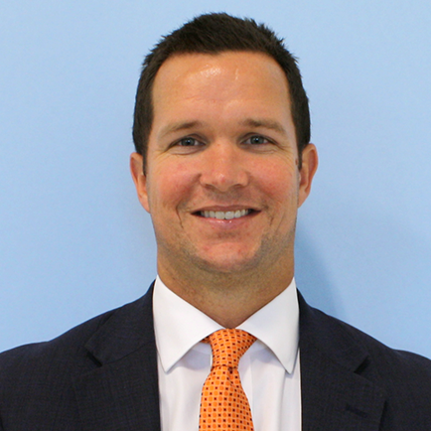
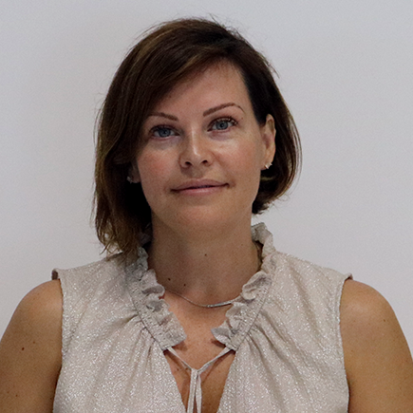
Universal Insurance Holdings (UVE): Subsidiaries
Mike Poloskey
VP of Underwriting
Stacey Tomko
VP of Marketing
William Degnan
VP of Claims
Keith Peer
VP of Catastrophe Operations
Matt Palmieri
President
Elizabeth Hansen
Senior Vice President
Patrick McCahill
President
Andrea Mineo
Director of Commercial Underwriting

Slide 11

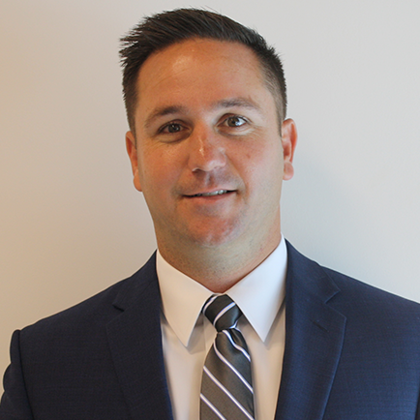
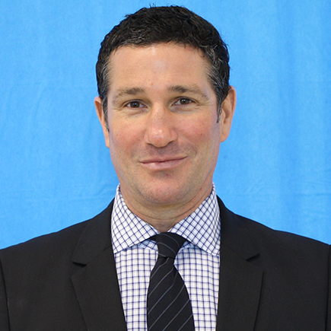
Universal Insurance Holdings (UVE): Subsidiaries
Sean McCahill
Vice President UDirect & Clovered
Ray McCall
Vice President
And 778 Additional Associates Committed To The Growth And Success Of The Company!

Slide 12
Universal Insurance Holdings (UVE): Four Pillars of Success
Utilize independent agency force to grow in all 18 states
Targeted growth via internal agencies Universal Direct and Clovered
Continue to evaluate new states and products for growth and expansion
Organic Growth
Exposure management through proprietary profit models in addition to licensing AIR and RMS catastrophe models
Constant rate review cycles to ensure adequate pricing in every state
Rate Adequacy
In-house claims department is organized by capability in order to efficiently accelerate close rates
Make customer service and continuous improvement a way-of-life
Claims
In-house reinsurance brokers, underwriters, and actuaries with insurance / reinsurance experience
Strong relationships with traditional reinsurance partners
A or better A.M Best rating for all reinsurance partners
Reinsurance

Slide 13
Universal Insurance Holdings (UVE): 2Q19 & 1H19 Results
Focus on disciplined growth
Total revenue up 11.4%; 1H19 up 17.2%.
Other states (Non-Florida) direct premiums written up 28.7%; 1H19 up 29.9%.
Diluted GAAP EPS of $1.08, non-GAAP adjusted EPS* of $1.05.
1H19 Annualized return on average equity of 28.7%; 1H19 combined ratio of 87.1%.
1
Maintain strong balance sheet
Our 2019-2020 reinsurance program successfully secured more catastrophe coverage than at any point in Company’s history.
YoY Book value per share up 17.4%.
YoY total unrestricted cash and invested assets up 6.2% to $1.1B.
2
Maximize earnings stability
Rate increases effective in Florida, Georgia, Massachusetts, Minnesota, and Pennsylvania.
Expanding our addressable market with Universal Property becoming licensed in Wisconsin.
Became licensed in more than 15 states and added five carrier appointments to our digital insurance distribution channel CloveredSM.
3
*Reconciliations of such non-GAAP financial measures in this presentation to the most comparable GAAP financial measures can be found in the Company’s earnings release for the second quarter of 2019, filed with the SEC as an exhibit to a Current Report on Form 8-K on July 31, 2019, and also available on the Company’s website at https://UniversalInsuranceHoldings.com under “Investors” with the subheading of “Earnings Releases.”

Slide 14
Universal Insurance Holdings (UVE): 2Q19 & 1H19 Results
Total Revenue
Annualized Return on Average Equity (ROE)
($million)
Premium volume, pricing, and investment portfolio driving growth, partially offset by realized losses related to underperforming equity securities
Total Revenue
+17.2%
Return on Average Equity
+11.4%
(7.4)pts
Pre-tax Income margin
(10.9)pts
Income before income tax | 61.2 | 50.9 |  | 112.9 | 104.7
Adjusted operating income* | 63.2 | 49.7 |  | 122.7 | 97.0
Earnings per Diluted Share (EPS)
Book Value, end of period
($ per share)
Geographically diversified growth, increased estimated losses, a reduced benefit from our claims adjusting business, non-recurring acquisition cost benefit in 2Q18, and higher effective tax rate
$ book value per share (BVPS)
$ million book value**
GAAP EPS | 1.29 | 1.08 |  | 2.42 | 2.22
+15.0%
+17.4%
Non-GAAP Adjusted EPS*
(21.1)%
(21.8)%
*Reconciliations of such non-GAAP financial measures in this presentation to the most comparable GAAP financial measures can be found in the Company’s earnings release for the second quarter of 2019, filed with the SEC as an exhibit to a Current Report on Form 8-K on July 31, 2019, and also available on the Company’s website at https://UniversalInsuranceHoldings.com under “Investors” with the subheading of “Earnings Releases.”
**Excludes preferred stock

Slide 15
Universal Insurance Holdings (UVE): What’s Important
Communication
People
Culture
Coaching

Slide 16
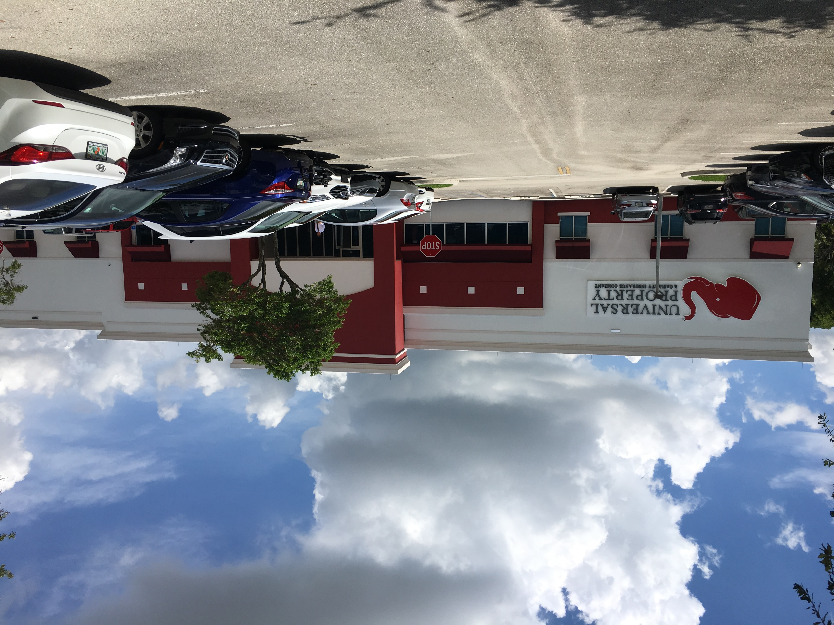
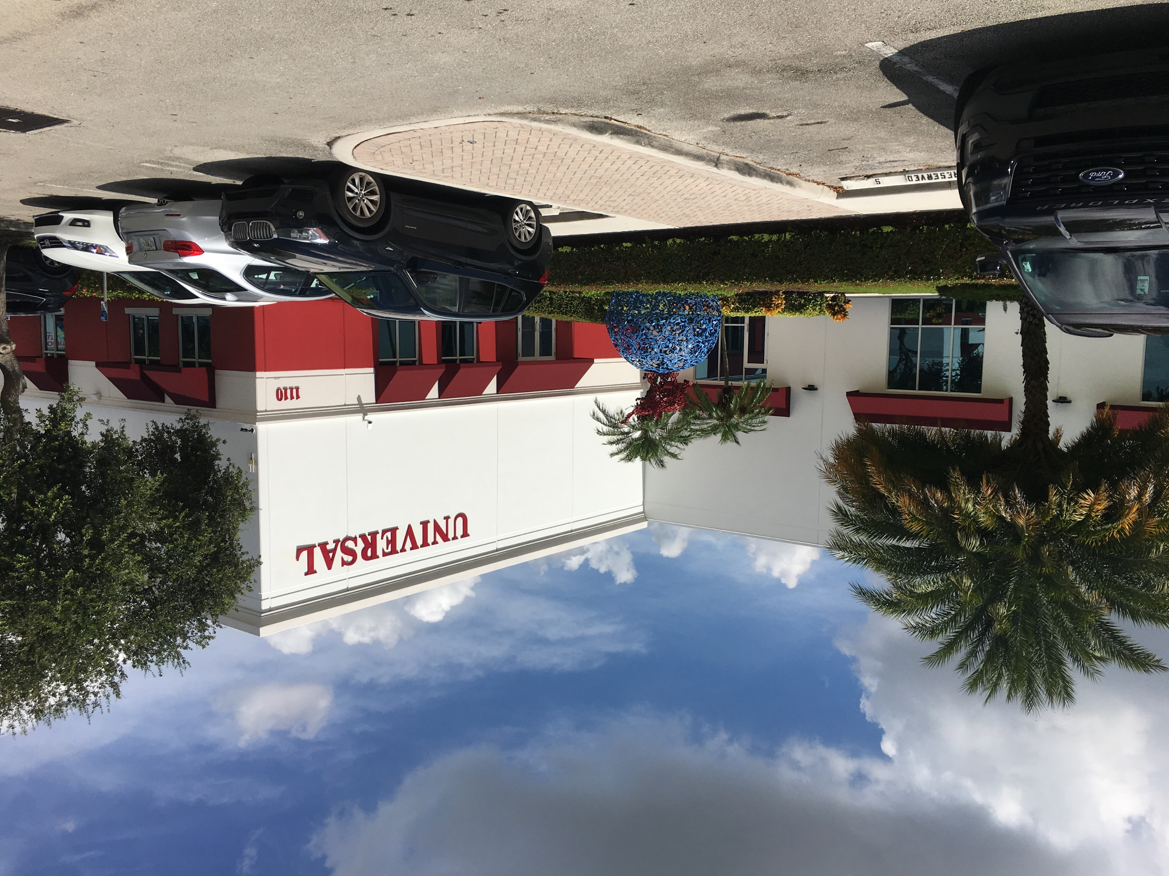
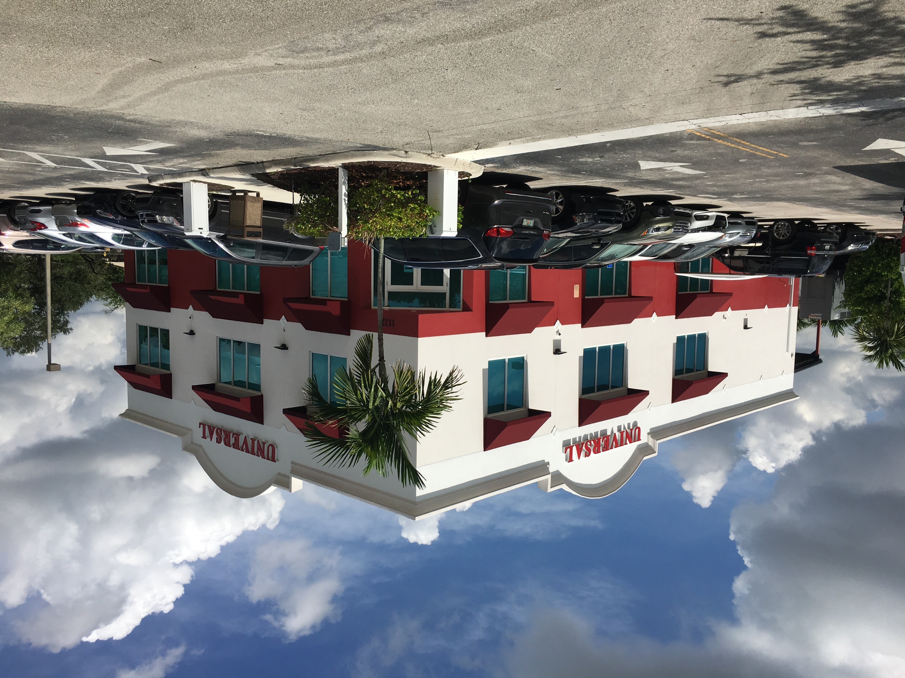
Universal Insurance Holdings (UVE): Campus Vision
Corporate Headquarters
Headquarters South
Headquarters North
Executive Management
Claims
Finance
Human Resources
Catastrophe Operations
Cafeteria
Underwriting
American Platinum
Regulatory Compliance
Learning & Development

Slide 17
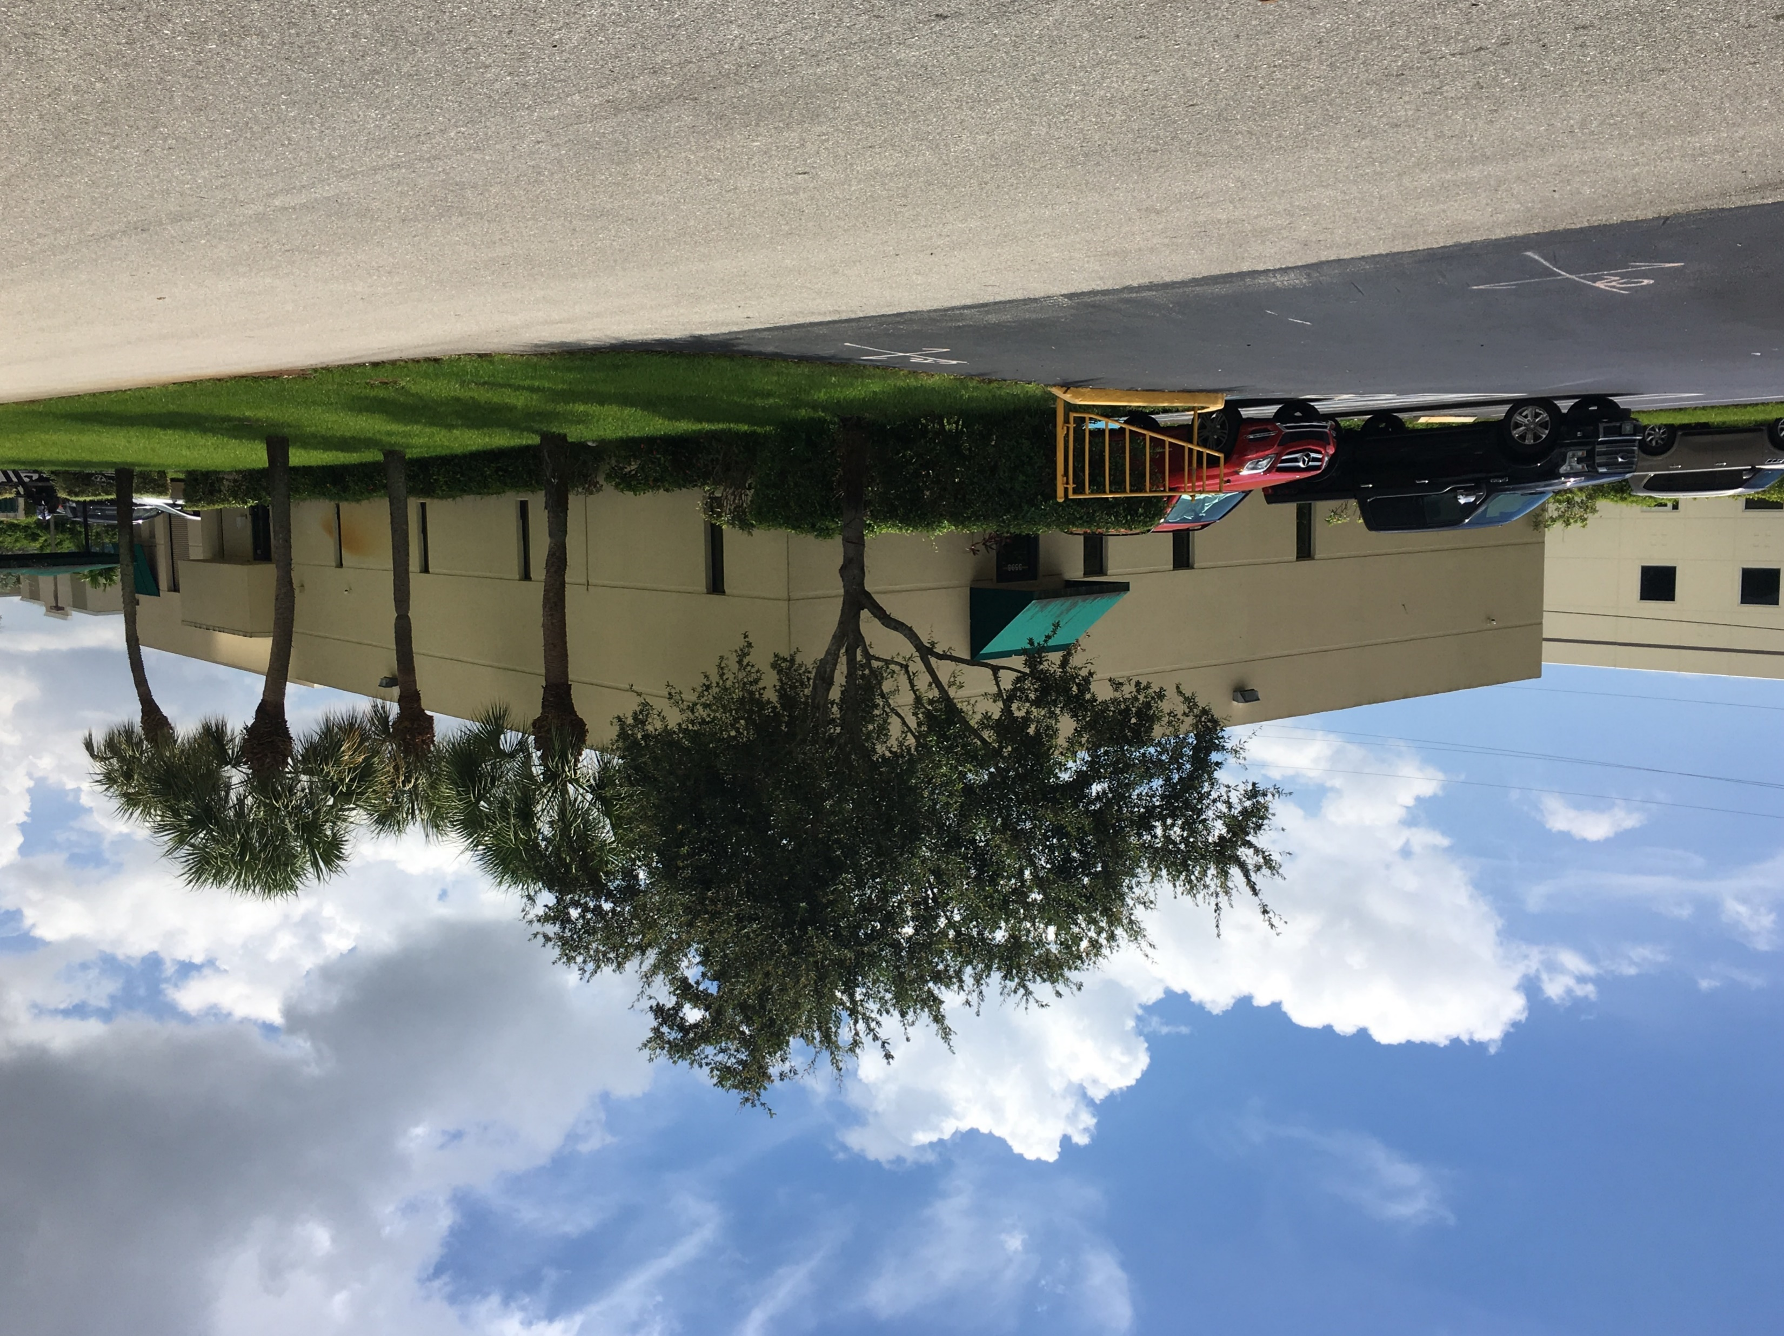
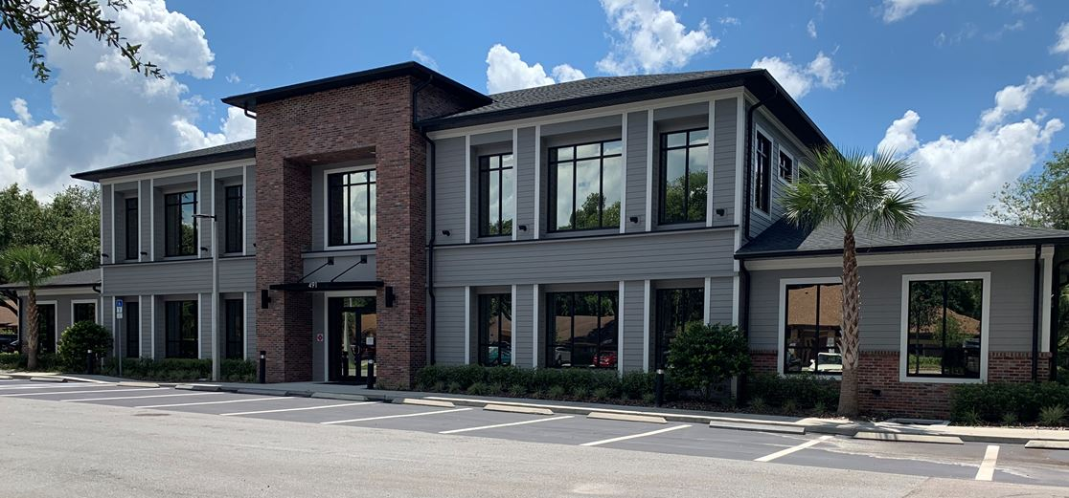
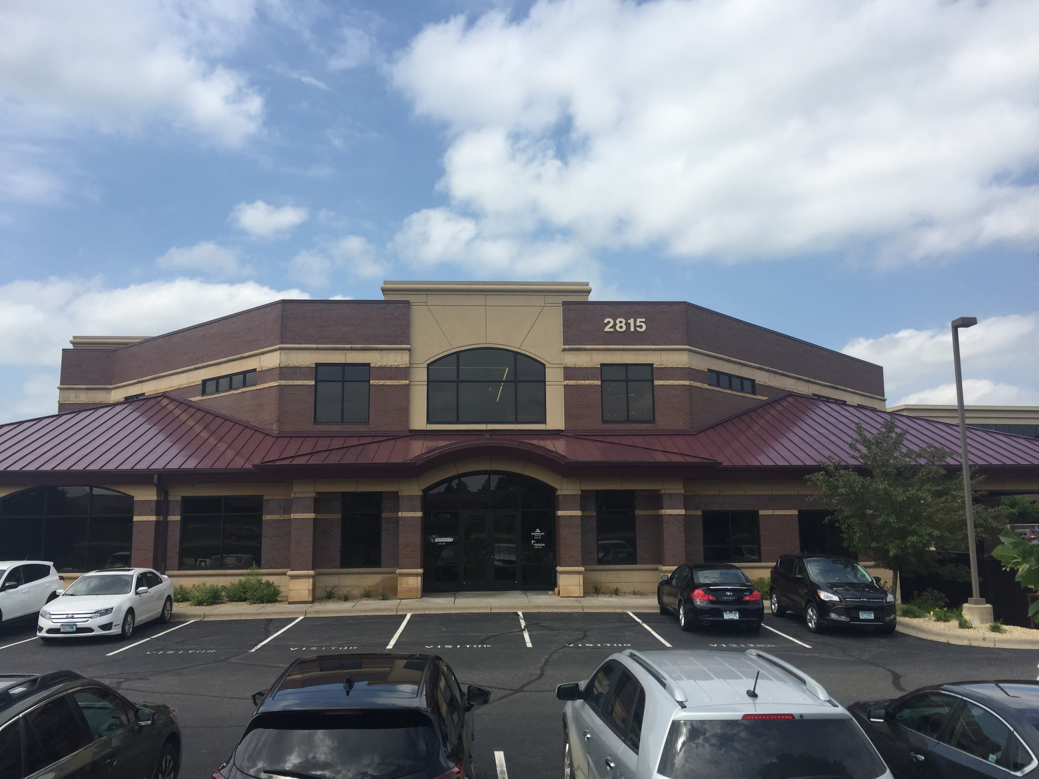
Universal Insurance Holdings (UVE): Campus Vision
Prospect
Altamonte Springs
Minnesota
Inspections
Mailroom
Print Fulfillment
Disaster Recovery storage
Maintenance
In-House Litigation Attorneys
Reinsurance
Exposure Management
Catastrophe Modeling
Actuarial Analysis

Slide 18
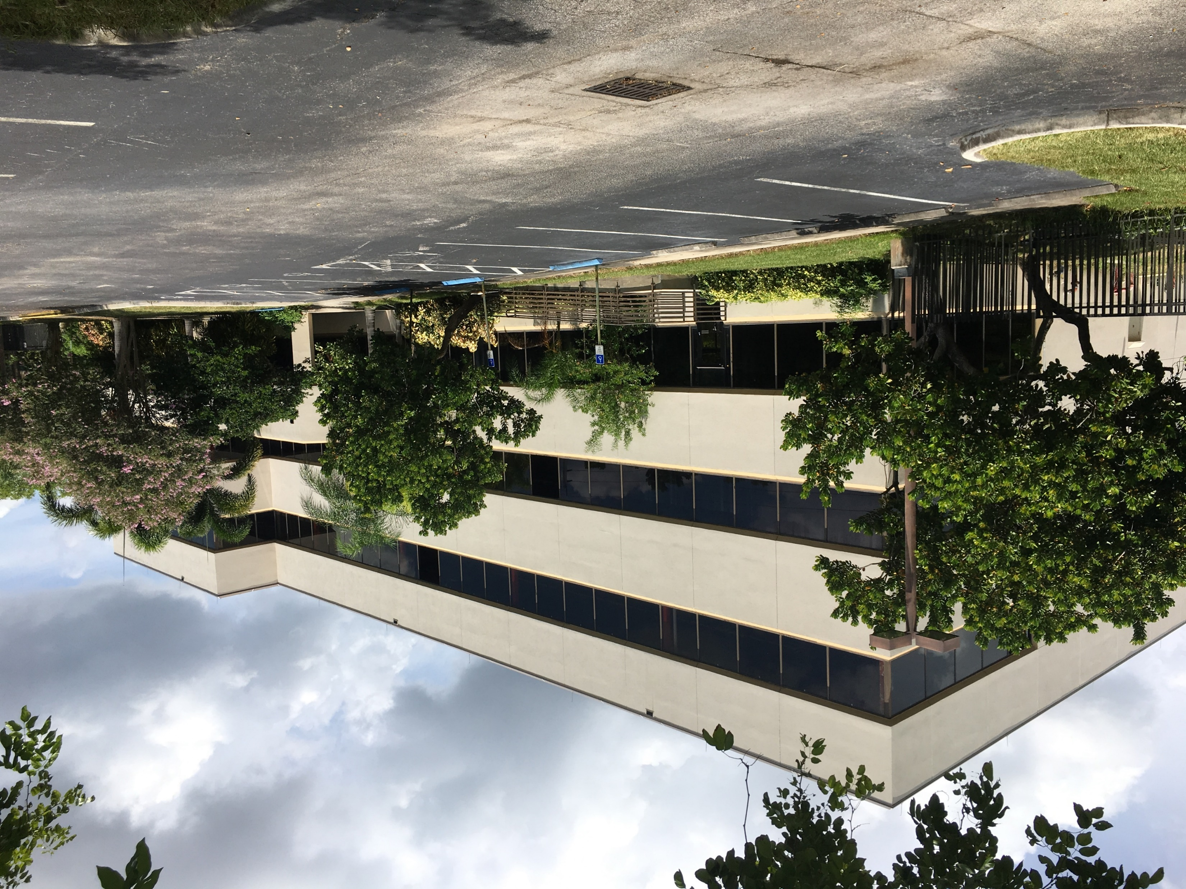
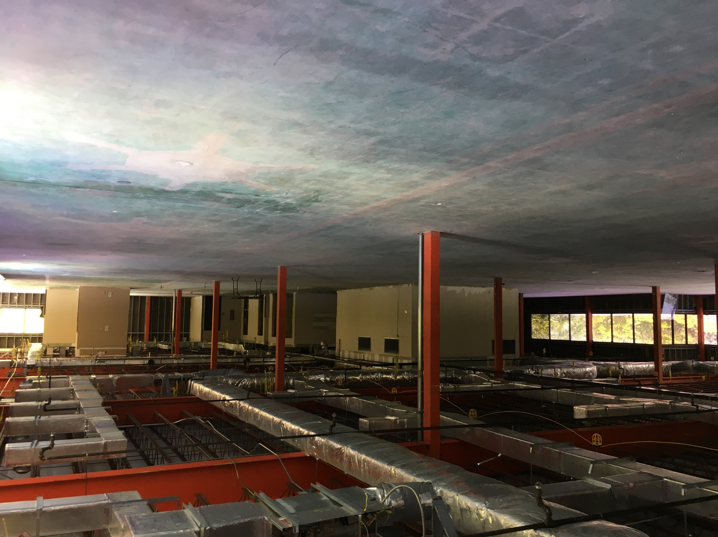
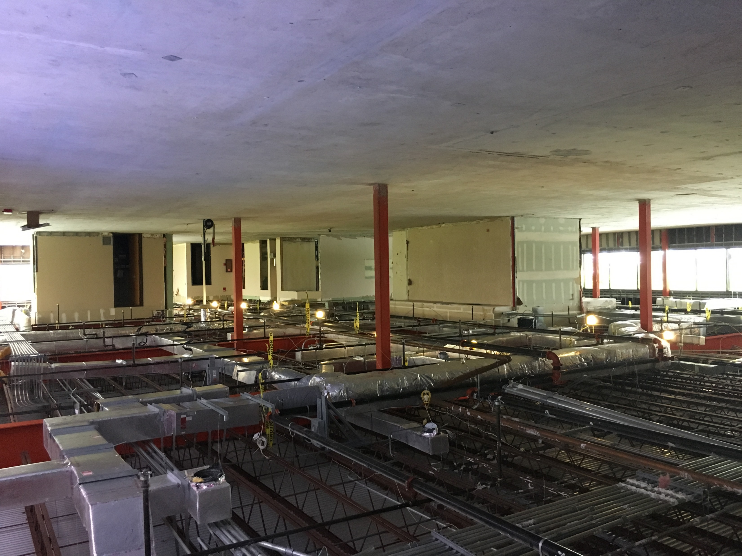
Universal Insurance Holdings (UVE): Campus Vision
New Fort Lauderdale location includes 50,000 square feet of office space and 284 parking spaces!
Marketing | Clovered | Software Development | Subrogation | Litigation

Slide 19
Question & Answer

